Slide 1
Python 2021.07.08 鄭紹雄 巫佶翰 @Deep Learning and Practice, Summer 2021

Slide 2
Outline
Environment
Built-in Functions
Packing and Unpacking
Class

Slide 3
Outline
Environment
Built-in Functions
Packing and Unpacking
Class

Slide 4
Environments
(Cloud) Google Colab
(NCTU) We’ll provide workstation
(Local) Install Python3
(Local / Remote) Jupyter Notebook

Slide 5
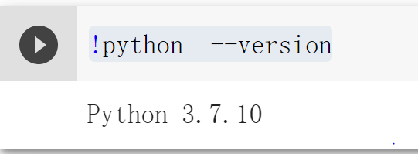
Python version
python >= 3.6
Command: python –V
Colab: !python --version

Slide 6
Outline
Environment
Built-in Functions
Packing and Unpacking
Class

Slide 7
Built-in Functions
Reference: Built-in Functions — Python 3.9.2 documentation

Slide 8
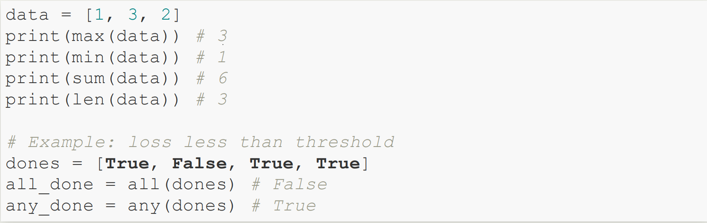
Example

Slide 9
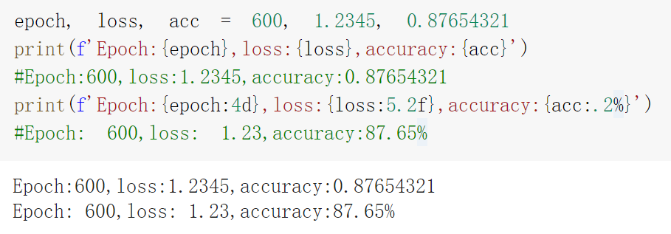
Format String
f as beginning
curly braces containing expression

Slide 10
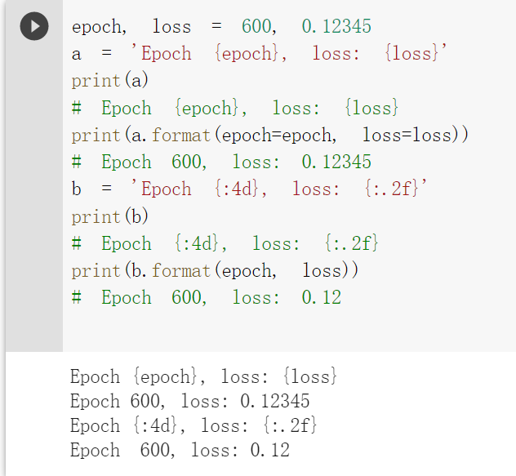
Format 方法
Notes:
使用內建format函數

Slide 11
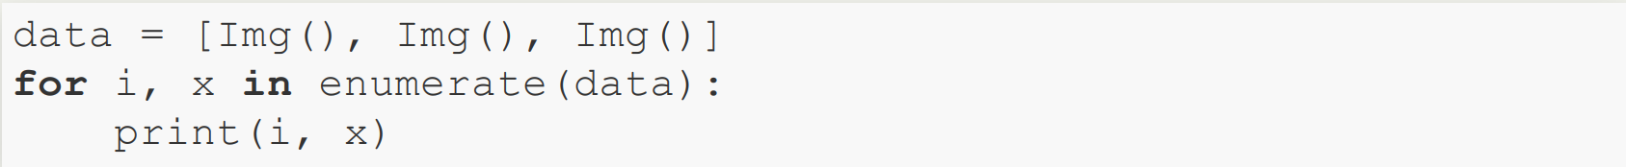
Enumerate
enumerate(iterable, start=0)

Slide 12
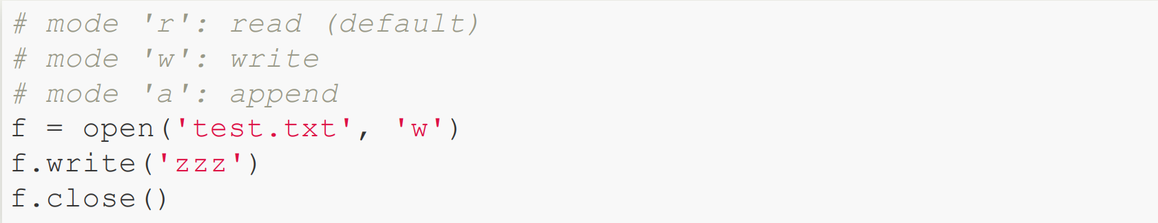
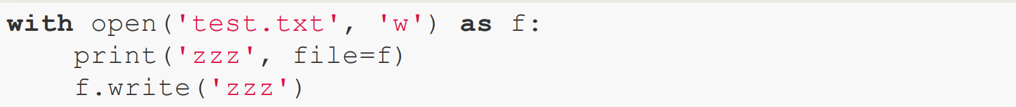
Open
with statement

Slide 13
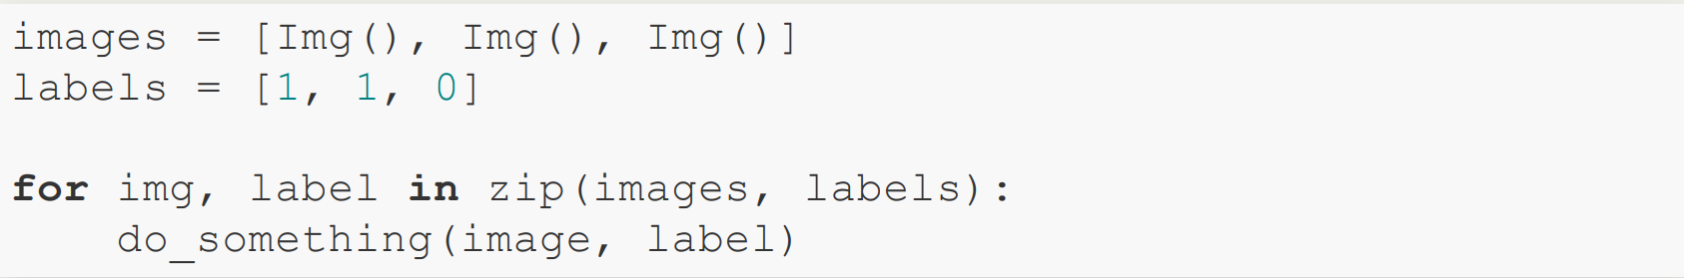
zip
enumerate, zip

Slide 14
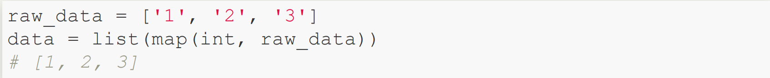
map

Slide 15
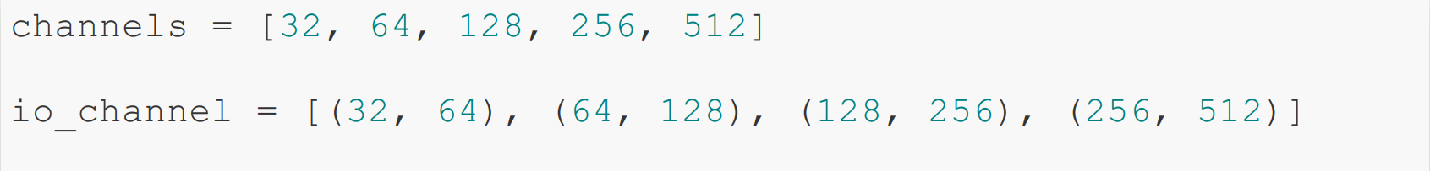
Practice 1
How to generate io_channel ?
Hint: zip, slice

Slide 16
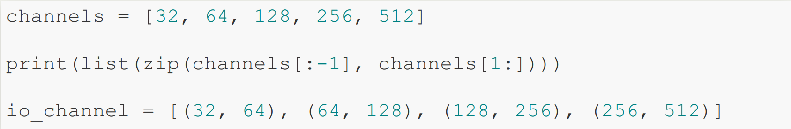
Practice 1 : Answer

Slide 17
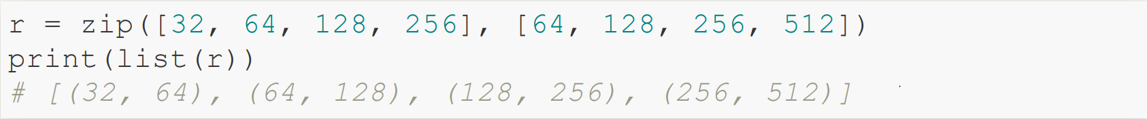
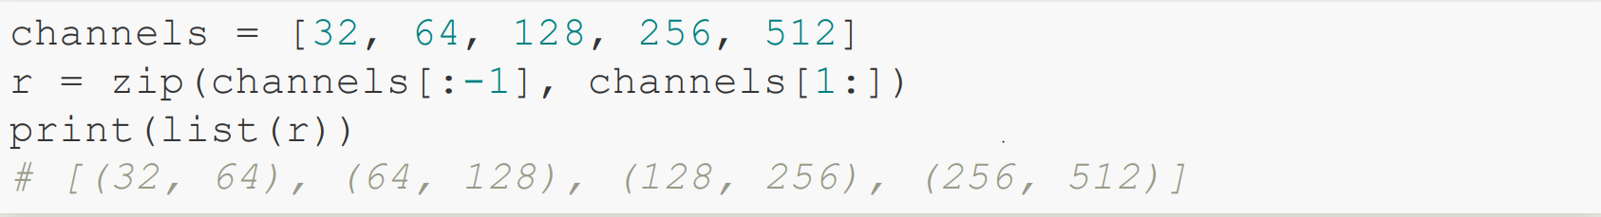
Practice 1 : Review

Slide 18
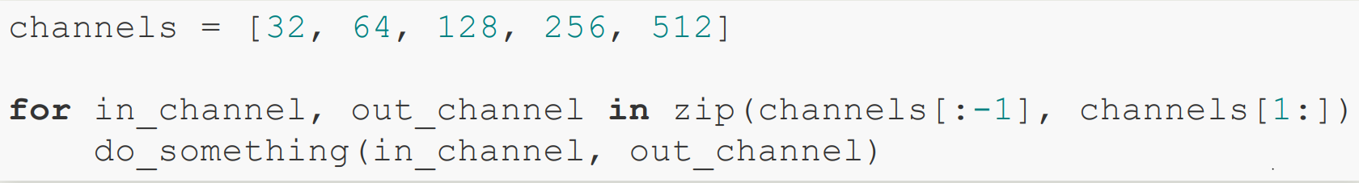
Practice 1 : Example

Slide 19
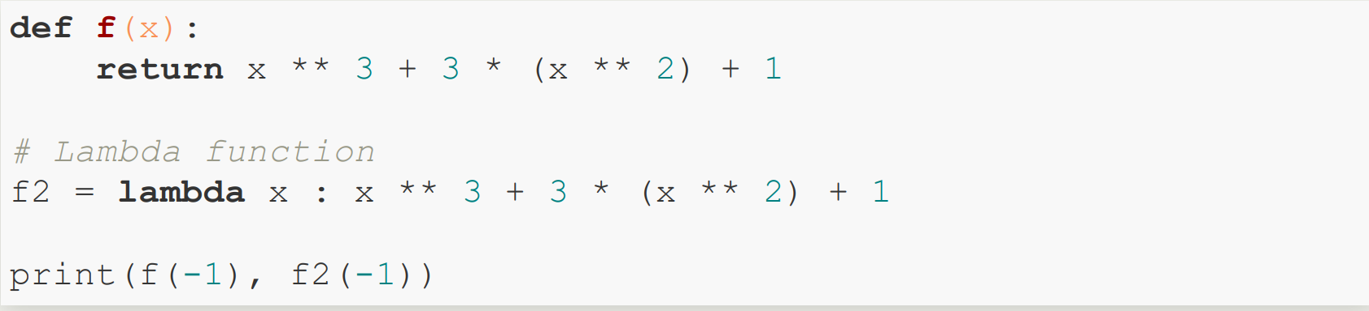
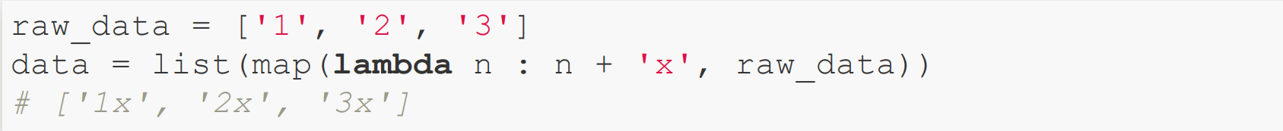
Lambda Function
Lambda Function with map function

Slide 20
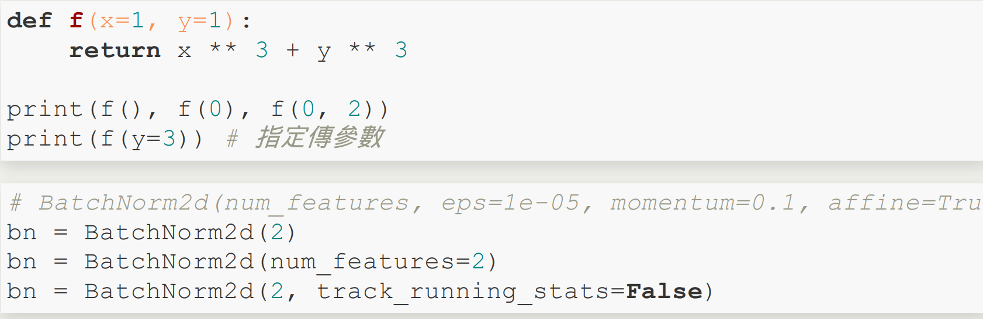
Positional Argument

Slide 21
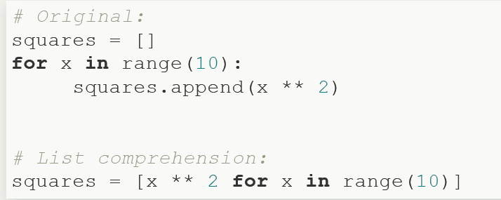
List Comprehensions
Output:
[0, 1, 4, 9, 16, 25, 36, 49, 64, 81]

Slide 22
Outline
Environment
Built-in Functions
Packing and Unpacking
Class

Slide 23
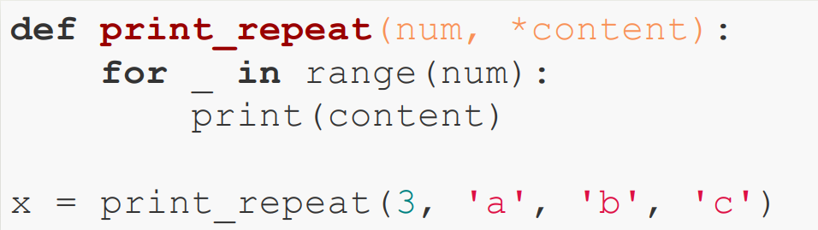

*args
Asterisks in Python are an operator for packing and unpacking.
packing example:

Slide 24
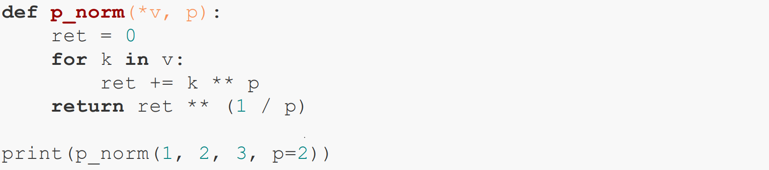

*args : example
packing example:

Slide 25
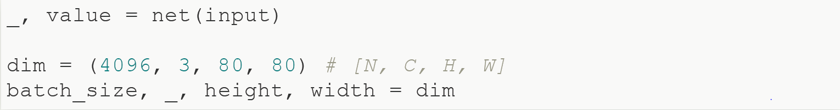
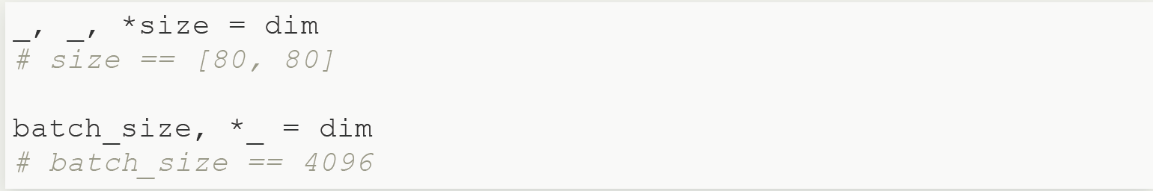
Iterable Unpacking
tuple, list, str
throwaway variable _
packing example:

Slide 26
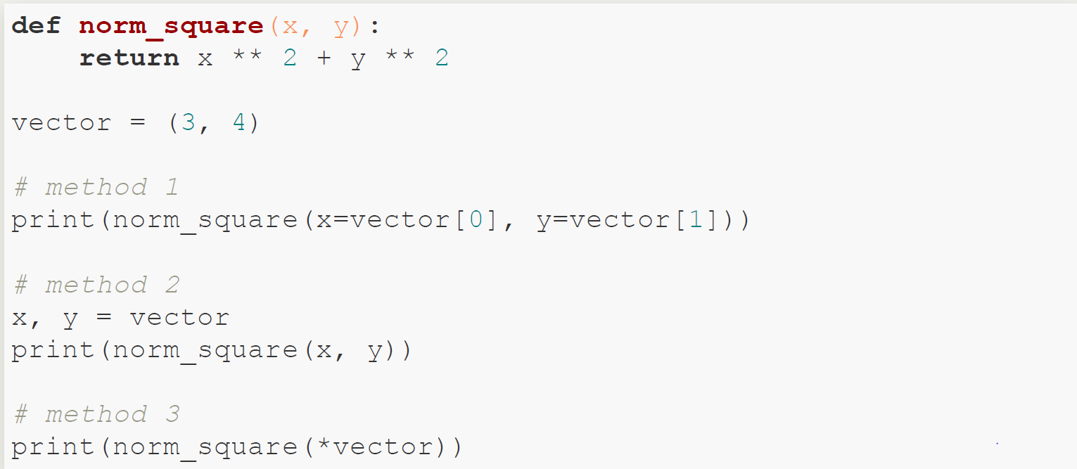
Iterable Unpacking: example
Example 1

Slide 27
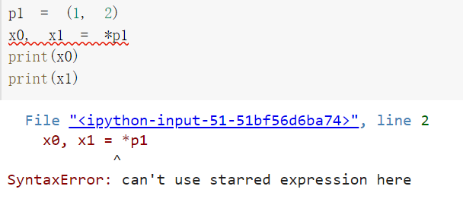
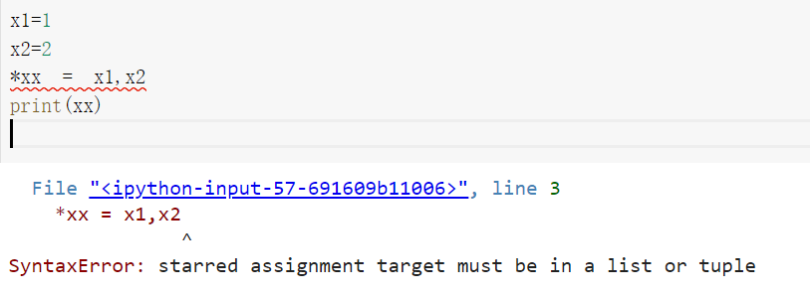
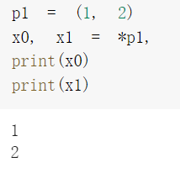
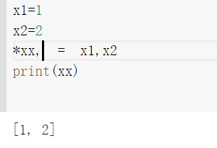
Iterable Unpacking: example
The comma after the starred expression is significant because it makes the entire expression of creating a tuple object.
Unpacking example
Packing example

Slide 28
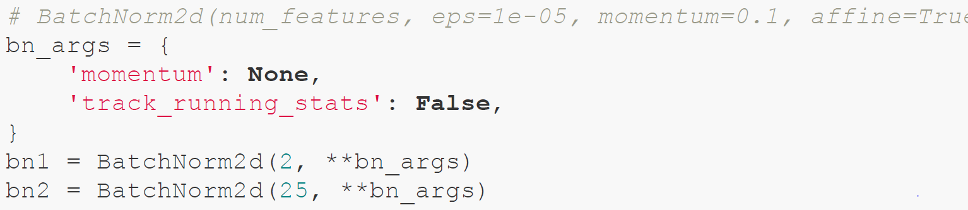
Dictionary Unpacking

Slide 29
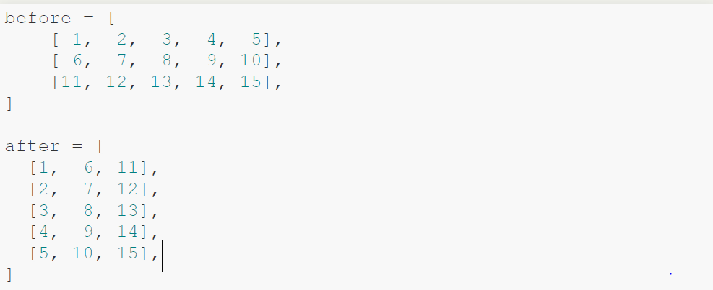
Practice 2: Transpose List of List
Hint: zip, list, map

Slide 30
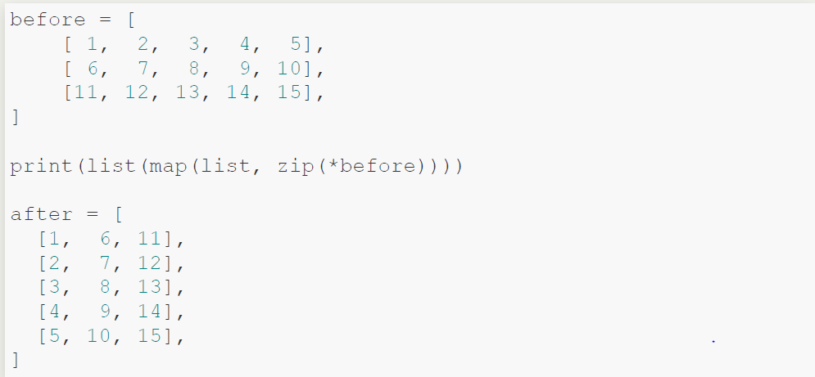
Practice 2: Answer

Slide 31
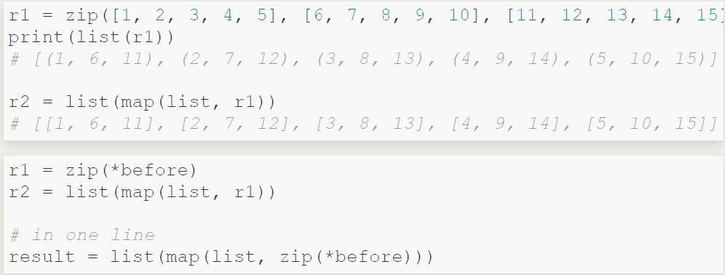
Practice 2: Review

Slide 32
Outline
Environment
Built-in Functions
Packing and Unpacking
Class

Slide 33
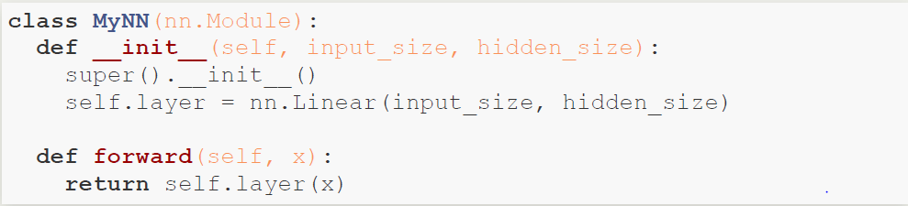
Class
inheritence from nn.Module

